Slide 1
Mechatronics training 3-dimensional multibody system in MATLAB SimScape Multibody
COC ​
January 9th 2023, Presenter Jasper Gerritsen
Slides originally by Stijn Beer
CONFIDENTIAL

Slide 2
Content
3D modeling in Simscape Multibody
Fundamentals Simscape multibody,
Modeling of the XYZ-motion platform,
Obtaining frequency response of the system,
Case study exercise.
CONFIDENTIAL

Slide 3
Fundamentals Simscape multibody
CONFIDENTIAL

Slide 4
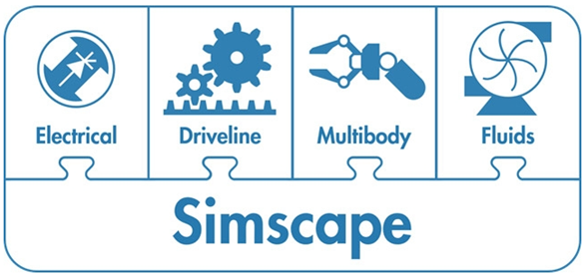
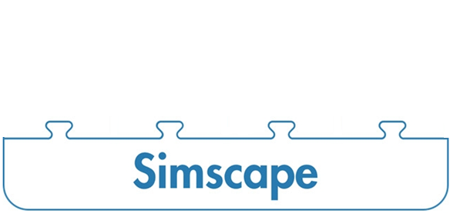
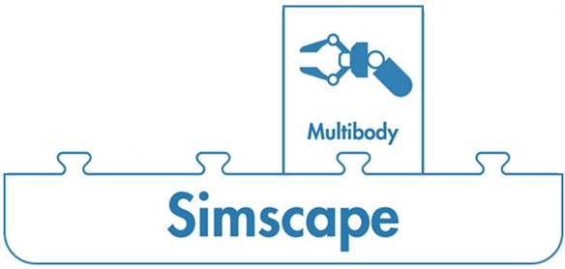
Fundamentals Simscape
The Simscape toolbox enables you to create models of physical systems within the Simulink environment.
Simcape Multibody is an add-on product that enables more complex (3-Dimensional) analysis capabilities.
Also other add-on products available.
CONFIDENTIAL
Notes:
The strength of using SimScape over other modelling tools is that is 1) integrated within Matlab and can be combined with strong control and data analysis tools but also connected to deep learning or code generation 2) has a capability for combining multiple physical domains.

Slide 5
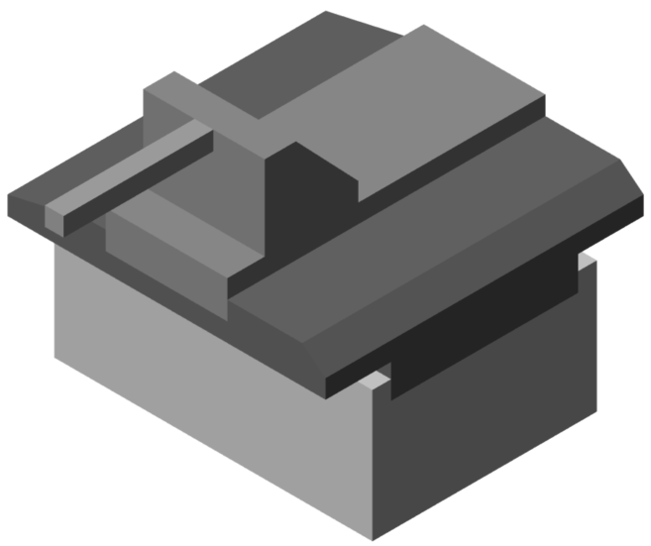
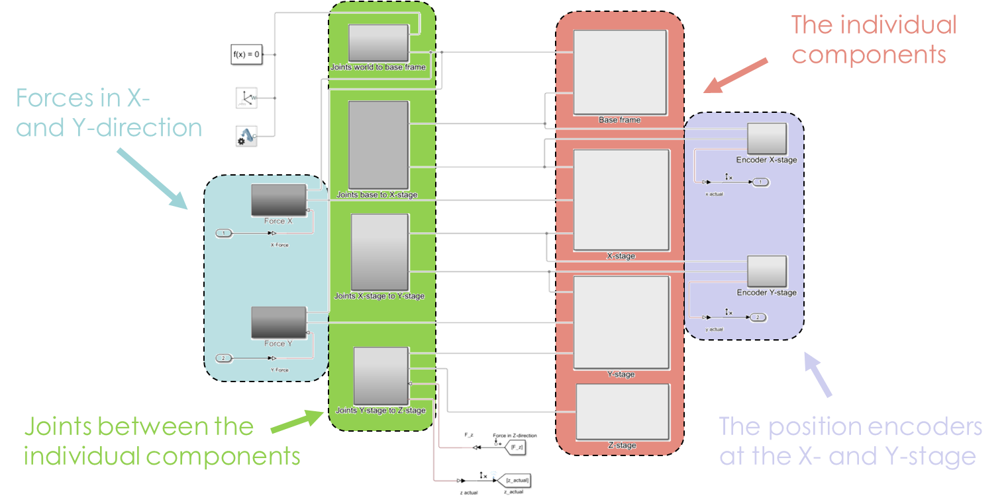

3-Dimensional modeling in Simscape Multibody
We use Simscape Multibody to create a multidimensional model of the XYZ-motion platform.
Hereby, motions in all directions are possible.
Base stage
X-stage
Y-stage
Z-stage
CONFIDENTIAL
Notes:
The model is separated into subsystems and groupings for clarity.
The subsystems denote individual system blocks. The colours here indicate the type of individual system block: bodies or components, joints, encoders and actuators.

Slide 6
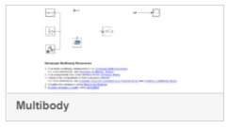

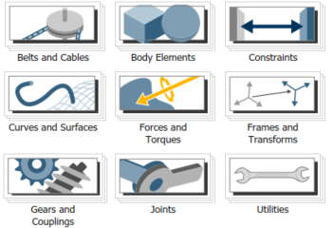
Simscape Multibody modeling
How to create a Multibody model?
Open a new Simcape model: under the Home tab press New > Simulink model. Go to the Simcape tab and create a Multibody model.
Among other components the resulting Simscape model already contains a solver, a world frame and a mechanism configuration.
Subsequently, we can select the desired Body Elements, Frames and Transformations and the Joints. These components can be found in the Simulink Library Browser > Simscape > Multibody.
CONFIDENTIAL
Notes:
We are going to do this step by step together!

Slide 7
Modeling the xyz-stage
CONFIDENTIAL

Slide 8


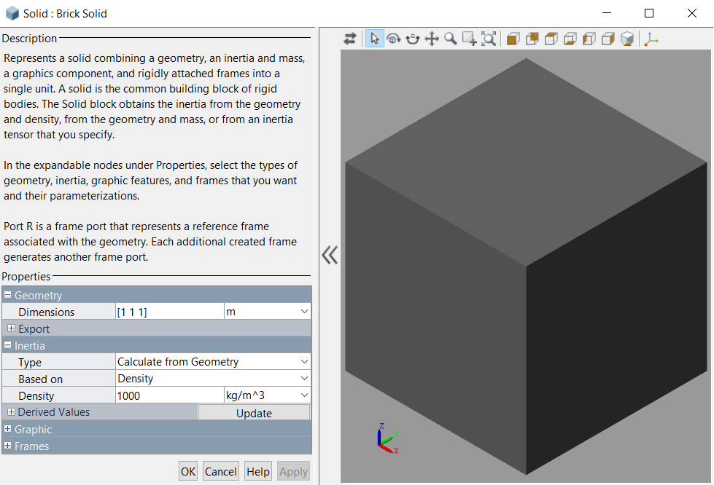
Creating a brick solid body element in Simscape Multibody
In the Simulink Library Browser > Simscape > Multibody double click on the Body Elements such that we can select the desired body.
We do not want to create a very complex model, and, hence, we select the Brick Solid component and drag it into the Simulink model.
Open the Brick Solid component by double clicking on it. Hereby, we want to adapt;
the dimensions,
the inertia.
CONFIDENTIAL
Notes:
Here we see the brick solid has a reference port. This reference port can connect via a signal to other SimScape multibody blocks. The key thing to note here is that a signal here is different to a signal that we are used to. Often a signal represents a time evolution of a certain quantity, this may be a physical quantity. However in SimScape multibody a signal and a port always represent the position and orientation of a reference frame.
The port represents an interface and a line can only ever represent

Slide 9
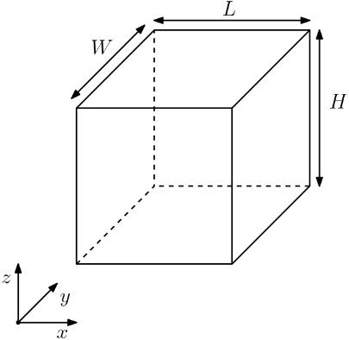
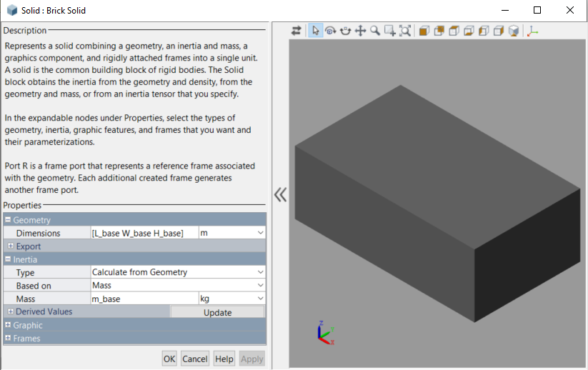

Model the body of the base stage
Inside the Brick Solid component we adapt;
the geometry,
the inertia based on the mass.
Define the dimensions and the mass of the body in a Matlab script:
Subsequently, we want to connect this body to the fixed world, but how?
CONFIDENTIAL
Notes:
The dimensions of the body are defined with respect to the body-fixed reference frame R. For the brick solid this means they extend by half in the positive and half in the negative direction of each axis. For this particular body this puts the body-fixed frame in the center of mass, but this is not always the case. For example for extruded solids often this will not be the case.
However, we can always choose to put another frame origin at the center of mass if we wish.

Slide 10
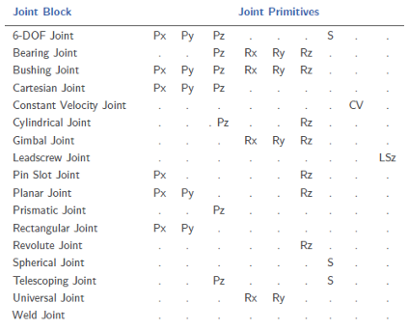
The available joints in Simscape Multibody
Joints are used to connect the different bodies to one another, or to connect a body to the fixed world.
The different joints that are available in Simscape Multibody are shown in the table on the right.
For each joint, the joint primitives indicate the possible motions. The most important ones are:
P (Prismatic) allows translation along a single standard axis (x, y or z).
R (Revolute) allows rotation about a single standard axis (x, y or z).
S (Spherical) allows rotation about any 3-D axis [x, y, z].
Which joint would you choose to connect the world to the base frame?
CONFIDENTIAL
Notes:
Think about which motions should be possible?
6-DOF joint is possible. Translations in x, y and z possible and rotations about the x-, y- and z-axis.
The same holds for the Bushing joint. However, this gives more freedom when defining the rotational constraints.
How about the planar joint?

Slide 11
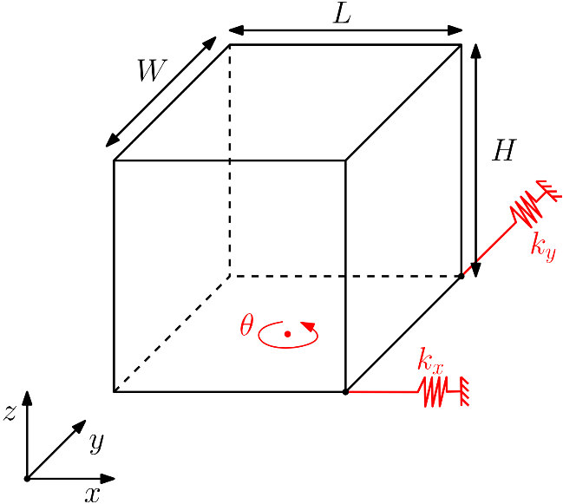
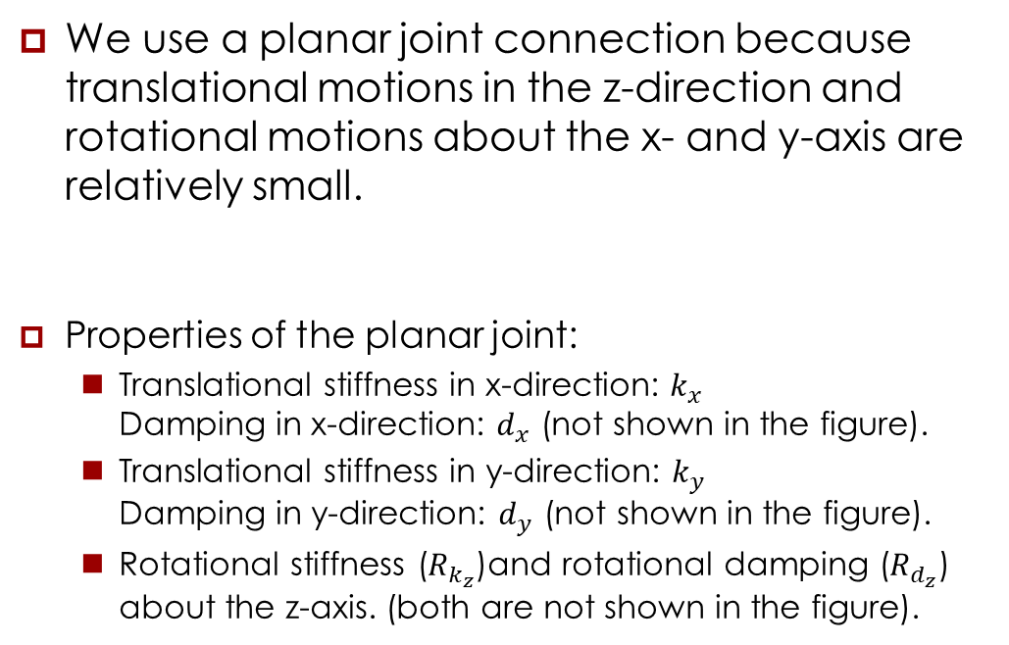
Planar joint properties
We use a planar joint connection because translational motions in the z-direction and rotational motions about the x- and y-axis are relatively small.
Properties of the planar joint:
Translational stiffness in x-direction: $k_{x}$ Damping in x-direction: $d_{x}$ (not shown in the figure).
Translational stiffness in y-direction: $k_{y}$ Damping in y-direction: $d_{y}$ (not shown in the figure).
Rotational stiffness ($R_{k_{z}}$)and rotational damping ($R_{d_{z}}$) about the z-axis. (both are not shown in the figure).
CONFIDENTIAL

Slide 12
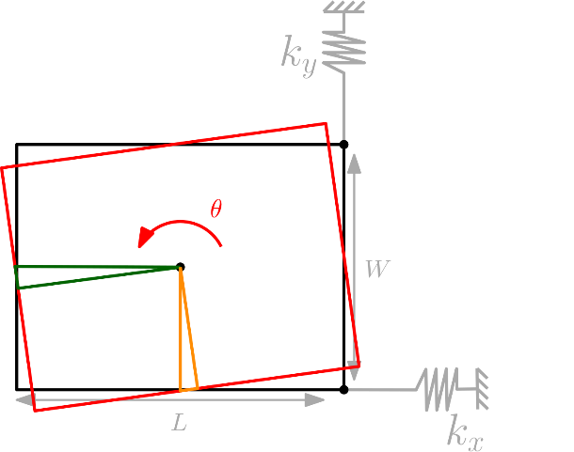
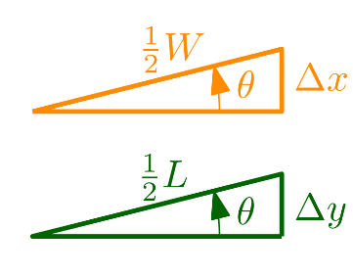
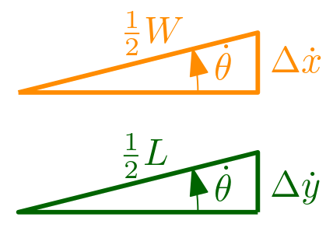

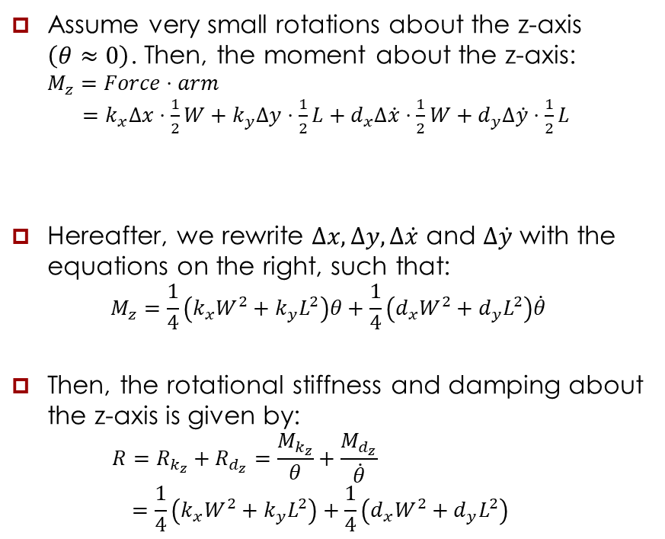



Defining the rotational planar joint properties
Assume very small rotations about the z-axis $\left(θ≈0\right)$. Then, the moment about the z-axis: $M_{z}=Force⋅arm$ $=k_{x}Δx⋅\frac{1}{2}W+k_{y}Δy⋅\frac{1}{2}L+d_{x}Δ\dot{x}⋅\frac{1}{2}W+d_{y}Δ\dot{y}⋅\frac{1}{2}L$
Hereafter, we rewrite $Δx, Δy, Δ\dot{x}$ and $Δ\dot{y}$ with the equations on the right, such that:
$$M_{z}=\frac{1}{4}\left(k_{x}W^{2}+k_{y}L^{2}\right)θ+\frac{1}{4}\left(d_{x}W^{2}+d_{y}L^{2}\right)\dot{θ}$$
Then, the rotational stiffness and damping about the z-axis is given by: $R=R_{k_{z}}+R_{d_{z}}=\frac{M_{k_{z}}}{θ}+\frac{M_{d_{z}}}{\dot{θ}}$ $=\frac{1}{4}\left(k_{x}W^{2}+k_{y}L^{2}\right)+\frac{1}{4}\left(d_{x}W^{2}+d_{y}L^{2}\right)$
Stiffness
Damping
$$Δx=\frac{1}{2}W\sin{θ}≈\frac{1}{2}Wθ$$
$$Δy=\frac{1}{2}L\sin{θ}≈\frac{1}{2}Lθ$$
$$Δ\dot{x}=\frac{1}{2}W\sin{\dot{θ}}≈\frac{1}{2}W\dot{θ}$$
$$Δ\dot{y}=\frac{1}{2}L\sin{\dot{θ}}≈\frac{1}{2}L\dot{θ}$$
Stiffness
Damping
CONFIDENTIAL

Slide 13


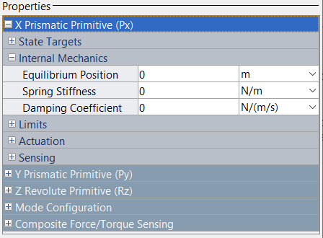
Creating a planar joint connection in Simscape Multibody
In the Simulink Library Browser > Simscape > Multibody double click on the Joints such that we can select the desired joint.
As discussed before, we select the Planar Joint component and drag it into the Simulink model.
Open the Planar Joint component by double clicking on it. Hereby, we want to adapt the internal mechanics of each Primitive.
CONFIDENTIAL

Slide 14
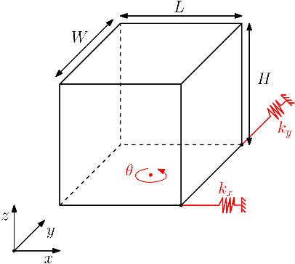
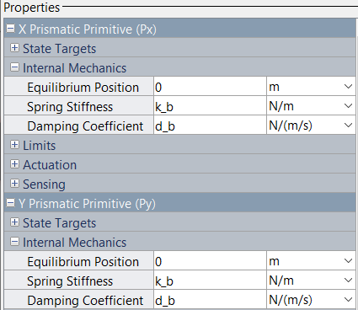

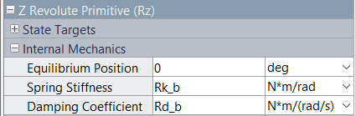
Model the planar joint between the base stage and the world
Inside the Planar Joint component we adapt;
the internal mechanics of the X Prismatic Primitive (Px),
the internal mechanics of the Y Prismatic Primitive (Py),
the internal mechanics of the Z Revolute Primitive (Rz).
Set the spring stiffnesses and the damping coefficients in a Matlab script:
The translational coefficients:
The rotational coefficients:
Are we now able to connect the body of the base stage to the fixed world?
CONFIDENTIAL

Slide 15
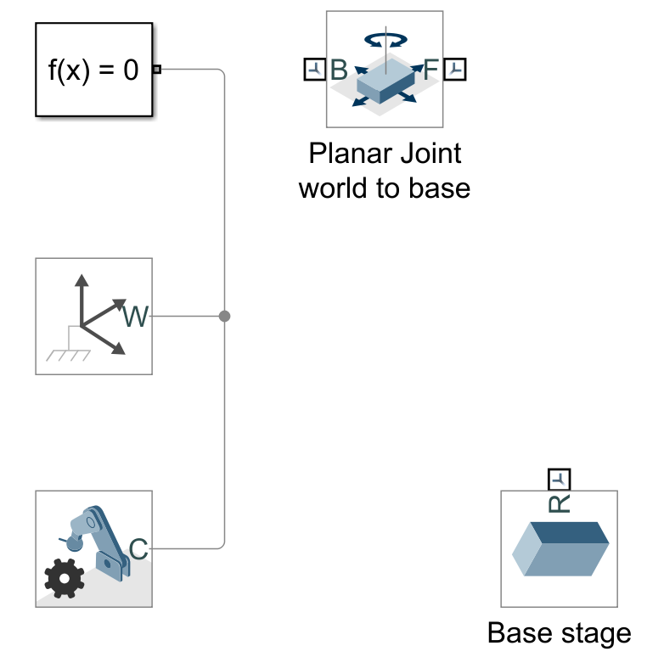
Intermediate Simscape Multibody model
Until this point, the model should contain:
a solver, a world frame and a mechanism configuration,
a planar joint component,
a brick solid component.
How should we connect these components?
CONFIDENTIAL

Slide 16
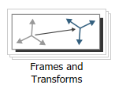

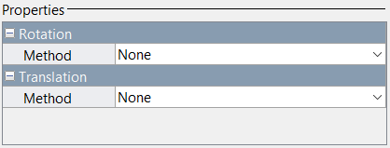
Creating a rigid transform in Simscape Multibody
In the Simulink Library Browser > Simscape > Multibody double click on the Frames and Transforms such that we can select the desired block.
Subsequently, we select the Rigid Transform component and drag it into the Simulink model.
Open the Rigid Transform component by double clicking on it. Hereby, we can perform a transformation between two frames.
CONFIDENTIAL

Slide 17
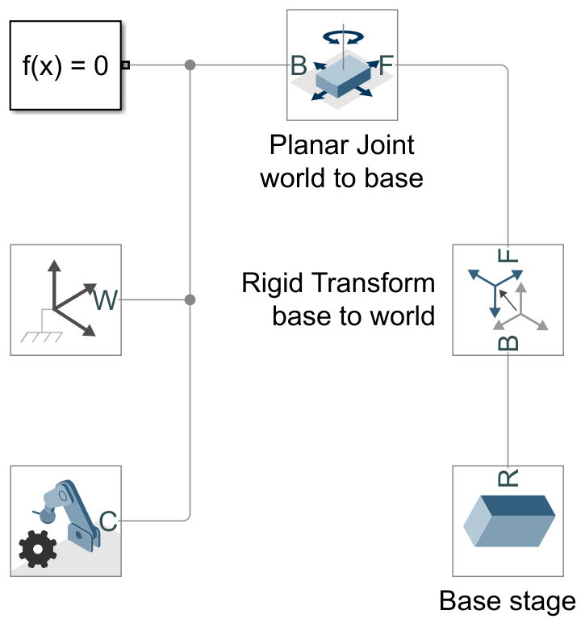
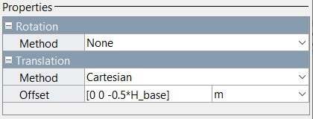
Connect the planar joint between the world and the base stage
First, we connect the base frame (B) of the Planar Joint to the fixed world.
Second, we connect the base frame (B) of the Rigid Transform to the reference frame (R) of the Brick Solid.
Lastly, we connect the follower frame (F) of the Planar Joint to the follower frame (F) of the Rigid Transform.
What should be the Rigid Transform?
CONFIDENTIAL

Slide 18
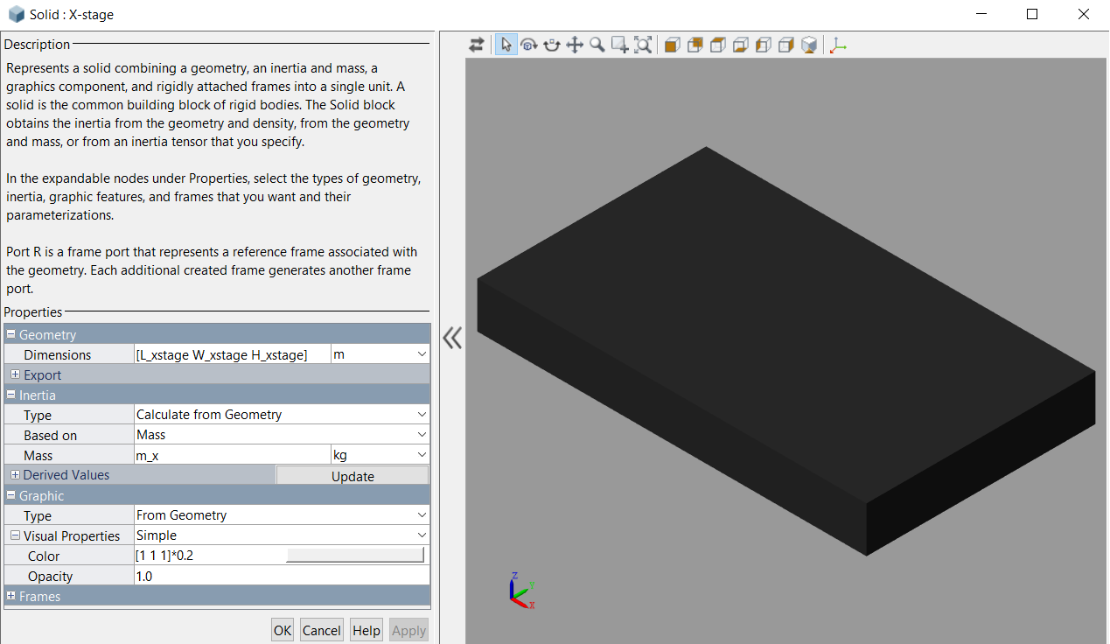

Model the body of the X-stage
Create a new Brick Solid component (see slide 8).
Inside the Brick Solid component we adapt;
the geometry,
the inertia based on the mass,
the graphics.
Define the dimensions and the mass of the body in a Matlab script:
Which joint would you use to make the connection to the base stage?
CONFIDENTIAL

Slide 19
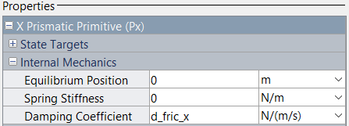

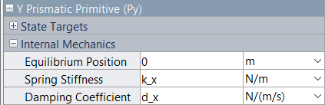
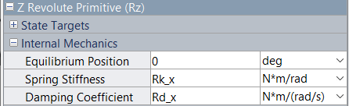
Model the planar joint between the base stage and the X-stage
Create a new Planar Joint component (see slide 12).
Inside the Planar Joint component we adapt;
the internal mechanics of the X Prismatic Primitive (Px),
the internal mechanics of the Y Prismatic Primitive (Py),
the internal mechanics of the Z Revolute Primitive (Rz).
Define the spring stiffnesses and the damping coefficients in a Matlab script:
The translational coefficients:
The rotational coefficients:
Do we need a Rigid Transform here?
CONFIDENTIAL
Notes:
The stiffness k_x and the damping d_x are the result of the guiding mechanisms.
What causes the difference between Rk_x and Rd_x? -> k_fric_x = 0 and hence ¼*k_fric_x*W_xstage^2 = 0. This term drops out.

Slide 20
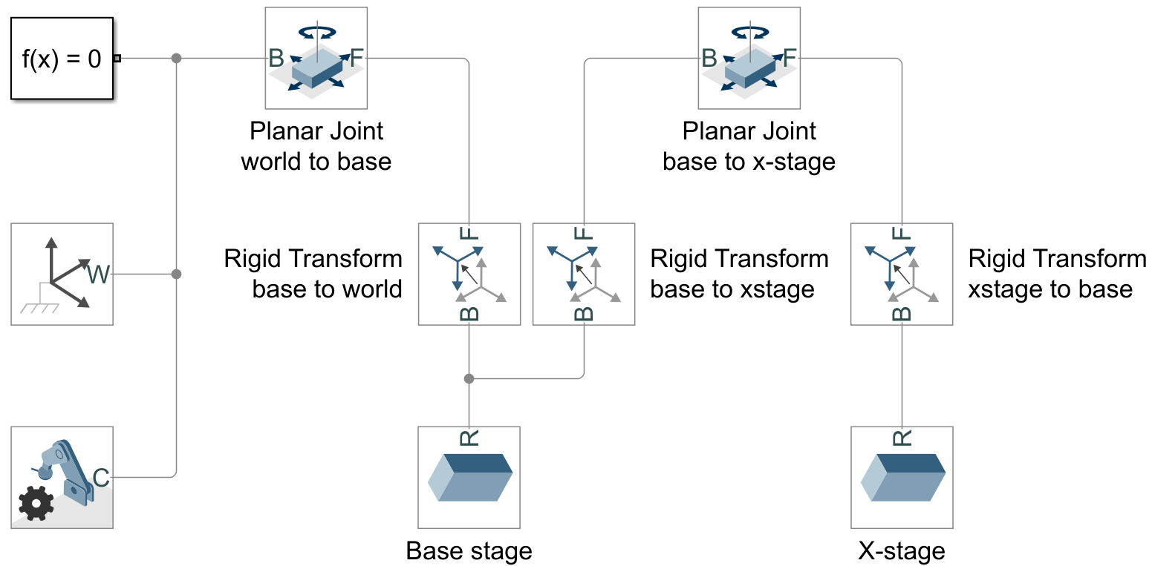
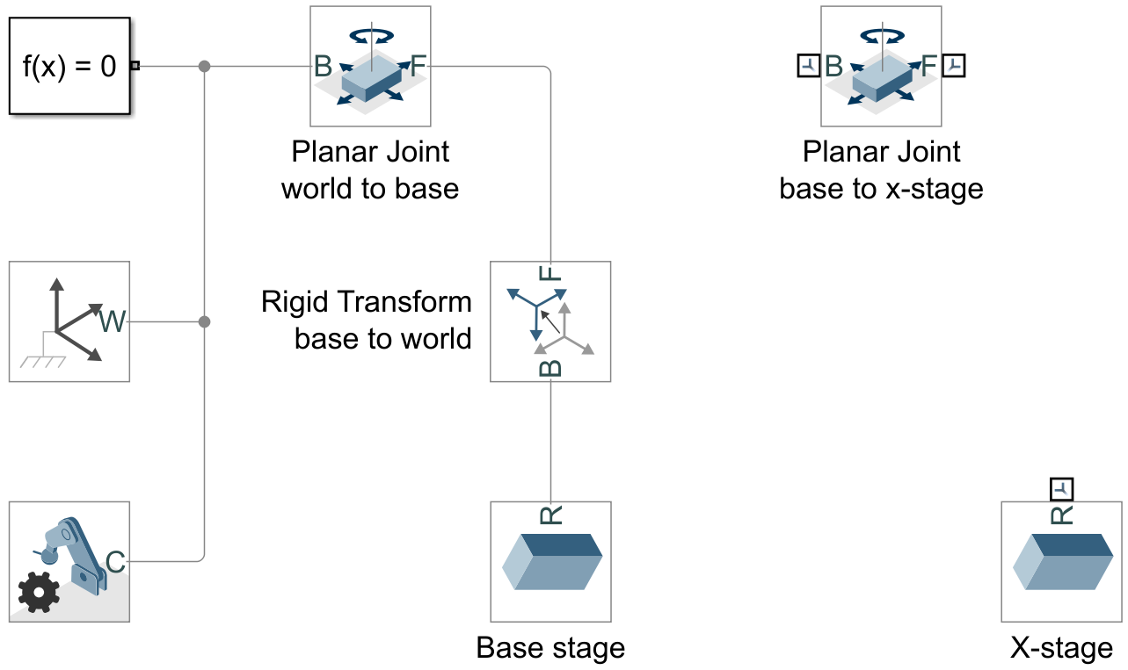
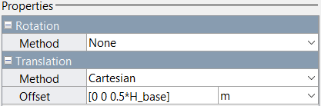
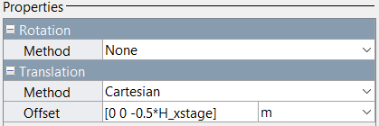
Intermediate Simscape Multibody model
Until this point, the model should contain:
a solver, a world frame and a mechanism configuration,
two planar joint components,
two brick solid components.
How should we connect these components? Rigid Transforms (see slide 17)?
How do these Rigid Transforms look?
CONFIDENTIAL

Slide 21

Coffee break
CONFIDENTIAL

Slide 22

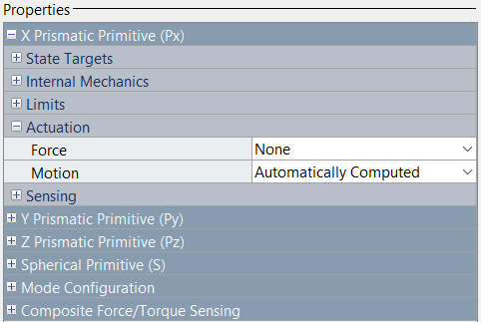
Applying forces in Simscape Multibody
In the Simulink Library Browser > Simscape > Multibody double click on the Joints such that we can select the desired joint.
Subsequently, we select the 6-DOF Joint component and drag it into the Simulink model.
Open the 6-DOF Joint component by double clicking on it. Hereby, we want to adapt the Actuation of the Primitive in the direction of the force.
CONFIDENTIAL

Slide 23
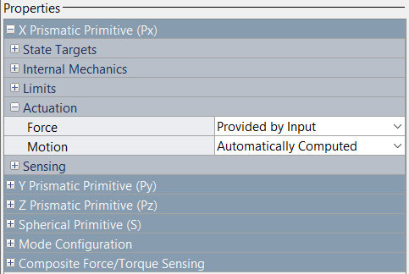


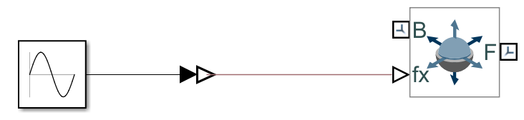
Model the force that acts on the X-stage
Inside the 6-DOF Joint component we adapt the Actuation Force in the x-direction.
In the Simulink Library Browser > Simscape open the Utilities folder, select the Simulink-PS Converter and drag it into the Simulink model.
In the Simulink Library Browser > Simulink open the Sources folder, select the Sine Wave and drag it into the Simulink model.
Connect the Sine Wave to the Simulink-PS Converter and the Simulink-PS Converter to the 6-DOF Joint.
CONFIDENTIAL

Slide 24
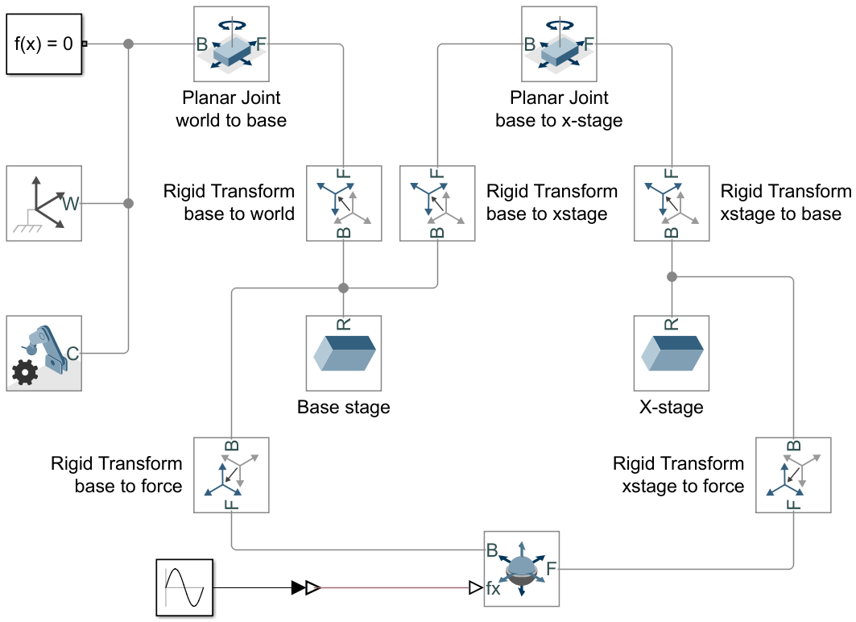
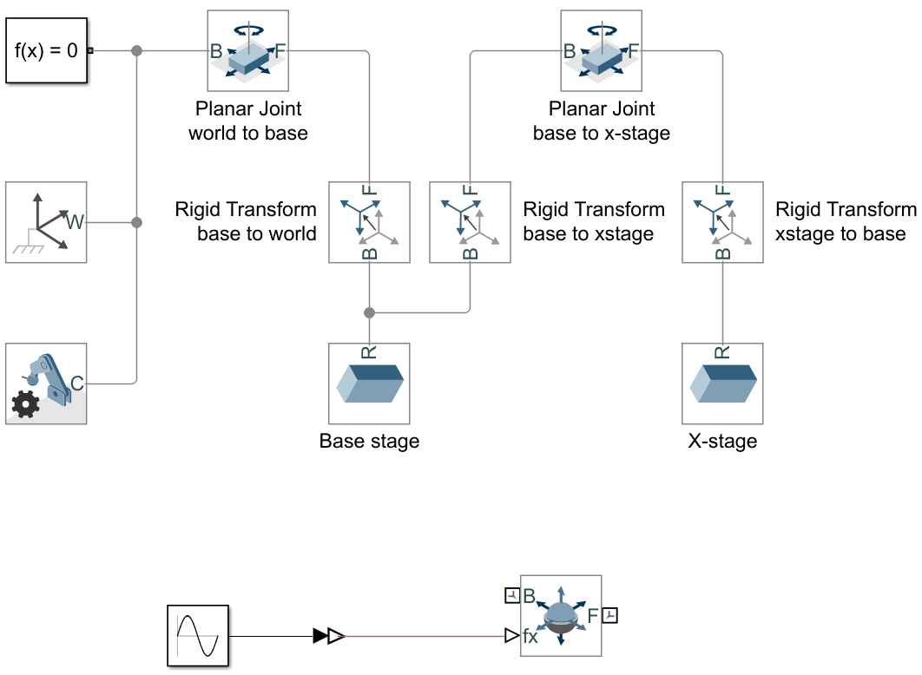
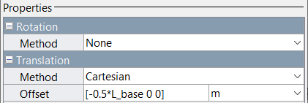
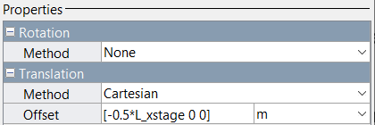
Intermediate Simscape Multibody model
Until this point, the model should contain:
a solver, a world frame and a mechanism configuration,
two planar joint components,
two brick solid components,
a 6-DOF joint and a sine wave.
How should we connect these components? Rigid Transforms (see slide 17)?
How do these Rigid Transforms look?
CONFIDENTIAL
Notes:
The actuator is located at the center of the left side of the X-guide and X-stage when standing in front of the machine. That means it will be positioned in the negative x-direction with distance L/2 with respect to the center of mass of the

Slide 25

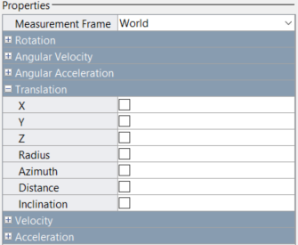
Applying sensors in Simscape Multibody
In the Simulink Library Browser > Simscape > Multibody double click on the Frames and Transforms such that we can select the desired block.
Subsequently, we select the Transform Sensor component and drag it into the Simulink model.
Open the Transform Sensor component by double clicking on it. Subsequently, we can choose the measurement type.
CONFIDENTIAL

Slide 26



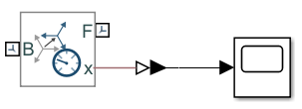
Model the sensor that measures the motion of the X-stage
Inside the Transform Sensor component we check the X-Translation box.
In the Simulink Library Browser > Simscape open the Utilities folder, select the PS-Simulink Converter and drag it into the Simulink model.
In the Simulink Library Browser > Simulink open the Sinks folder, select the Scope and drag it into the Simulink model.
Connect the Scope to the PS-Simulink Converter and the PS-Simulink Converter to the Transform Sensor.
CONFIDENTIAL

Slide 27
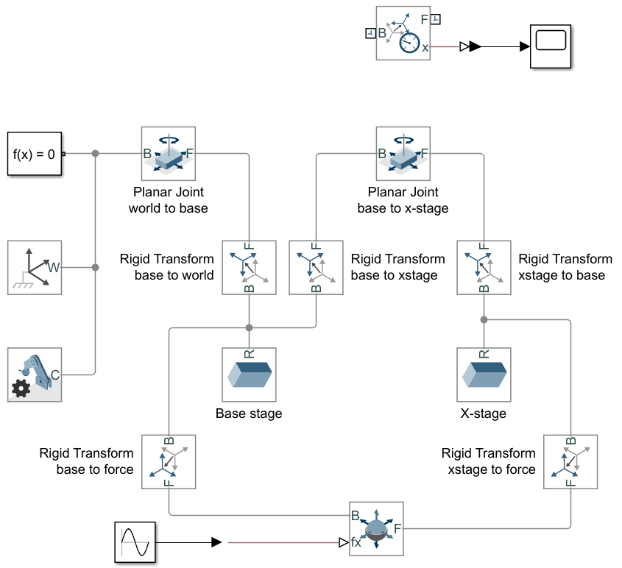
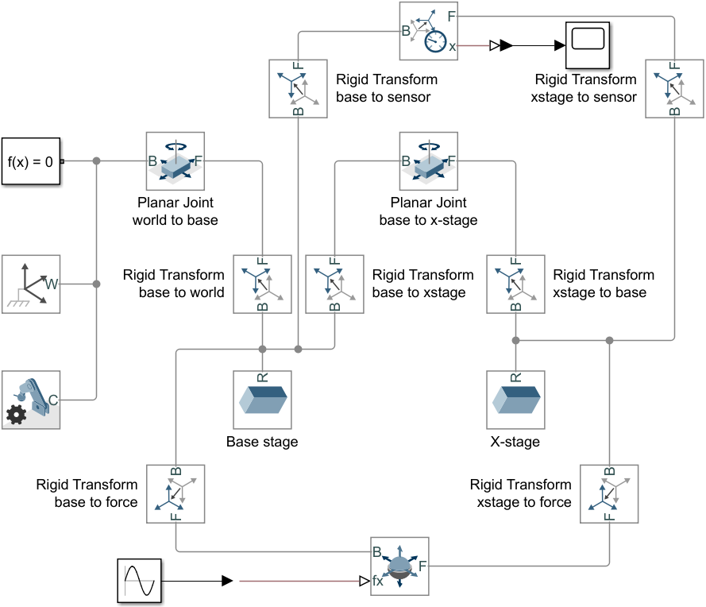
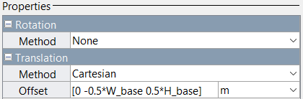
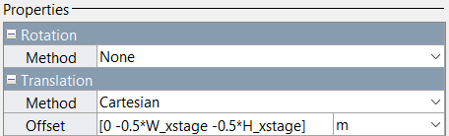
Intermediate Simscape Multibody model
Until this point, the model should contain:
a solver, a world frame and a mechanism configuration,
two planar joint components,
two brick solid components,
a 6-DOF joint and a sine wave,
a Transform Sensor and a scope.
How should we connect these components? Rigid Transforms (see slide 17)?
How do these Rigid Transforms look?
CONFIDENTIAL

Slide 28
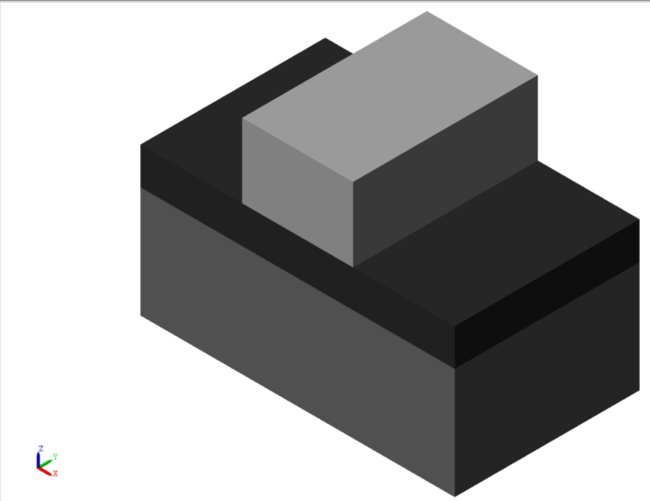
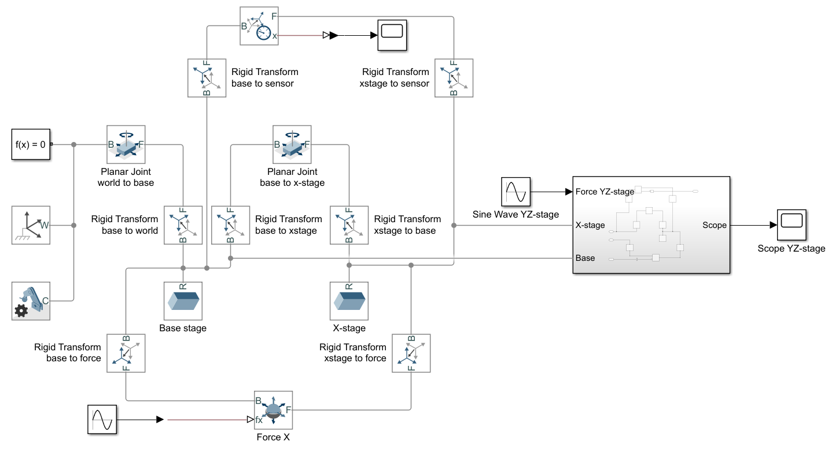


Completing the Simscape Multibody model
The resulting components are hidden because these will be a part of today’s exercise.
CONFIDENTIAL

Slide 29
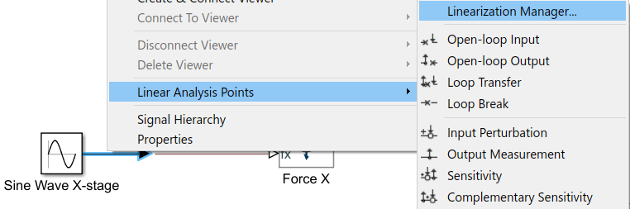

Frequency response of the Simscape Multibody model
We want to evaluate the frequency response of the developed Simscape Multibody model with;
the two forces ($F_{x} and F_{y}$) as inputs,
and the two encoders ($x and y$) as outputs.
Therefore, we need to define these in- and outputs in the Simscape Multibody model.
Right click with your mouse on the desired signal and click on Linear Analysis Points.
Then you can choose whether the signal is input perturbed or whether the signal is the open- loop output.
CONFIDENTIAL

Slide 30


Frequency response of the Simscape Multibody model
Subsequently, we write in our Matlab script that we want to know the input/output settings of the Simscape Multibody model.
This information is used to linearize the system at the specified operating point (in this case the center position).
This results in the 2x2 system in state- space form, and is plotted by using;
CONFIDENTIAL

Slide 31
Case study
CONFIDENTIAL

Slide 32
Case study: complete the Simscape Multibody model
Now it is your turn to complete the model:
model the mass of the YZ-stage,
create the planar joint between the X-stage and the YZ-stage,
create the necessary rigid transforms,
create a force between the YZ-stage and the base stage,
create a sensor that measures the position of the YZ-stage.
Create the Bode plot of the 2x2 Simscape Multibody system.
CONFIDENTIAL

Slide 33


Case study: complete the Simscape Multibody model
$$F_{yz}$$
The encoder is located at the red dot at half of the length YZ-stage.
The force acts on the middle of the back face YZ-stage, and the reaction force acts on the middle of the base stage.
$$F_{yz}$$
CONFIDENTIAL

Slide 34

Questions
CONFIDENTIAL

